Slide 1


SCIENTIFIC CALCULATOR
D SRINIVASREDDY
192011400

Slide 2
AIM
Calculators perform the basic arithmetic functions—addition, subtraction, multiplication, and division—and many can also do more complicated calculations, such as normal and inverse trigonometric functions
This is to create calculator which is used for:
Addition
Subtraction
Multiplication
Division of numbers
Calculators perform the basic arithmetic functions—addition, subtraction, multiplication, and division—and many can also do more complicated calculations, such as normal and inverse trigonometric functions
*

Slide 3
Abstract
Calculators are part and parcel of modern education. Involvement of science and engineering in different fields of knowledge is increasing with each bit of time is passed by, and they are playing a role in description and characterization of the delicate phenomena of nature arising day by day.
These fields of knowledge and mathematics in particular, are influencing even those distant branches of knowledge, which were so far imagined to be free of mathematics.
Even art is not free of mathematics and there exists mathematical art.
Computations are getting lengthy and complex specially in design and analysis of engineering systems. Scientific calculators are handy tools.
But an efficient computation is a skill that can be developed.

Slide 4
Objective
In maths a scientific calculator is a valuable and useful tool, since it allows the user to solve more difficult equations greater than one or two terms quickly and easily.
Equations with a scientific calculator are commonly used in maths, physics and other sciences

Slide 5

Introduction
Unlike basic calculators that can only handle smaller values, a scientific calculator can handle numbers on a much vaster scale, which can be useful when it comes to collecting data or working as a physicist or chemist.
It can also calculate negative scientific notation

Slide 6

PROPOSED SYSTEM
Windows laptop (Any operating System)
Android Studio
Emulater
Android software Or ( Android Mobile )

Slide 7



APP TOOLS

Slide 8
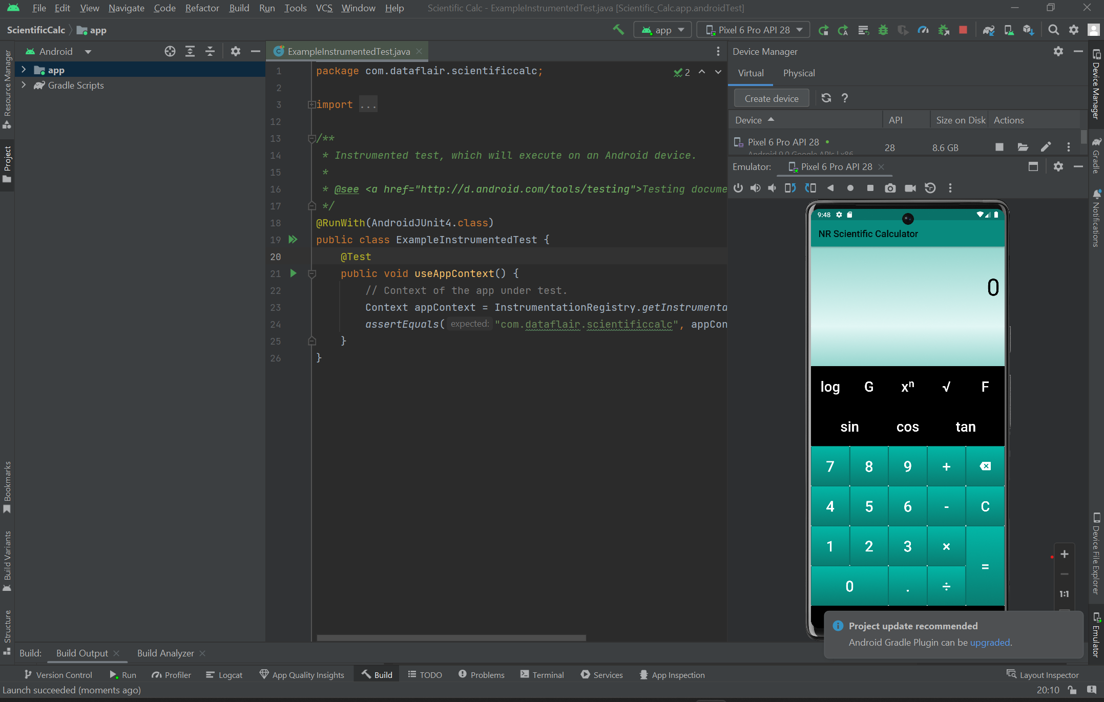
IMPLEMENTATION OF TESTING

Slide 9
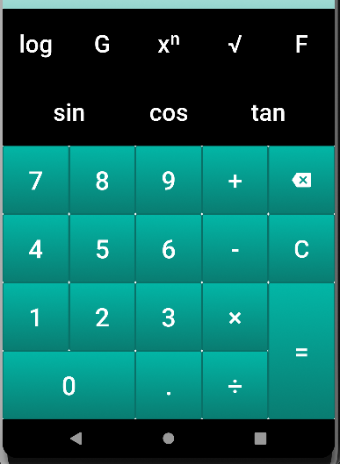
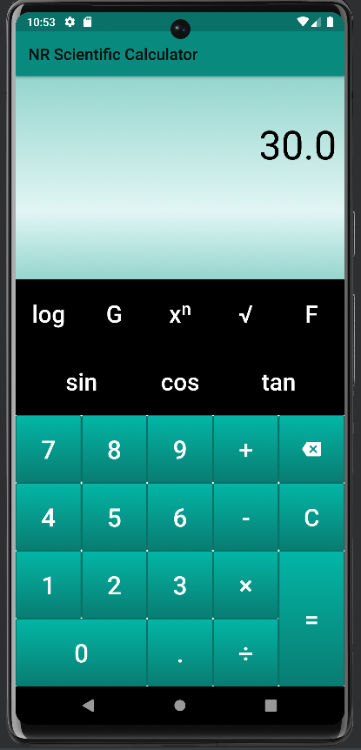
MODULE DESCRIPTION
Modular description provides the detailed information about the calculator model and its supposed components ,which is accessible in different manners
The included description is available by reading directly ,by generating a short html description ,or by making an environment check for supported components to check if all needed types and services are available in the environment where they will be used.

Slide 10
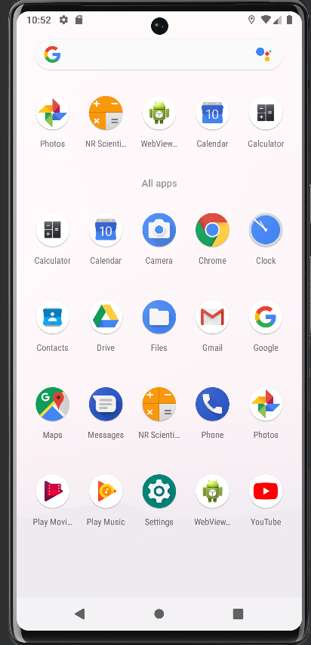
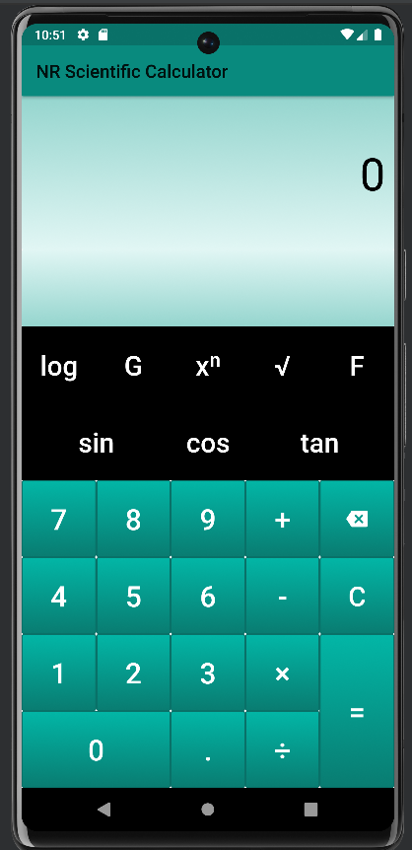
SCREENSHOT OF OUTPUT

Slide 11
INSTALLATION
EXISTING WORK
Calculator
Download Android Studio.
Install SDK in Android Studio.
Download Emulator in Android Studio.
Download Appium Server and Inspector.
Download and install IntelliJ.
A calculator is a device that performs arithmetic operations on numbers.
Basic calculators can do only addition, subtraction, multiplication and division mathematical calculations.

Slide 12
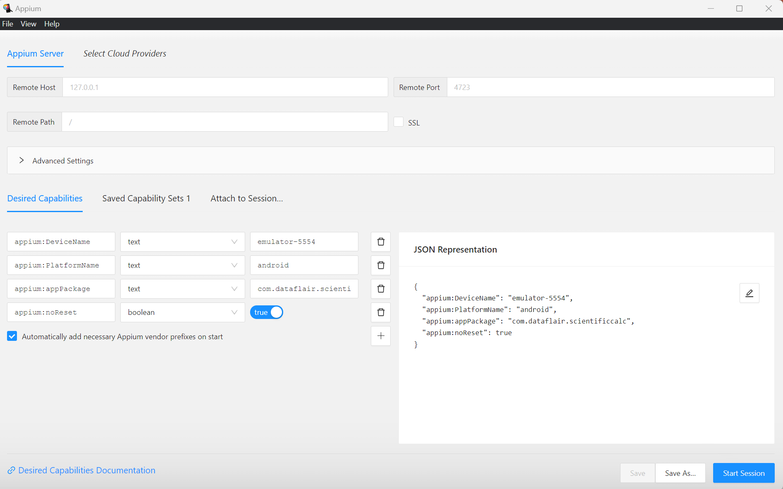
Appium Inspector

Slide 13
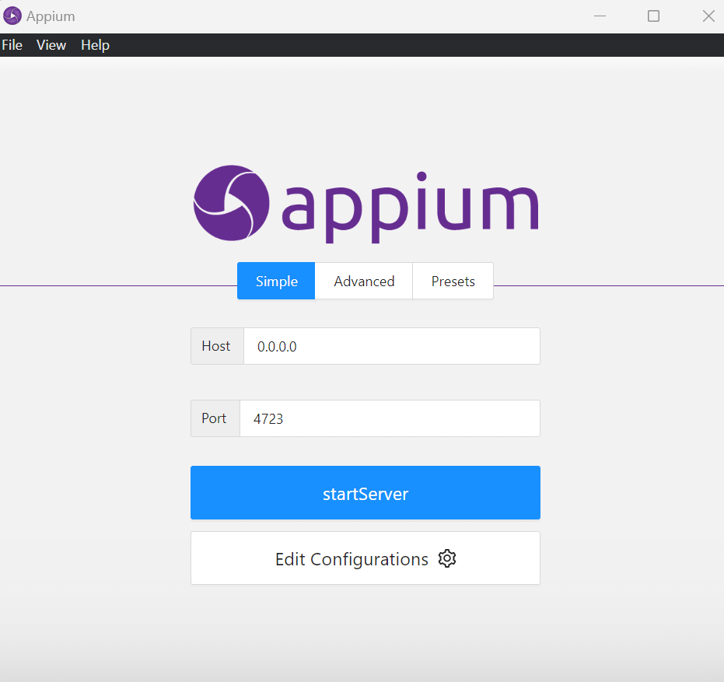
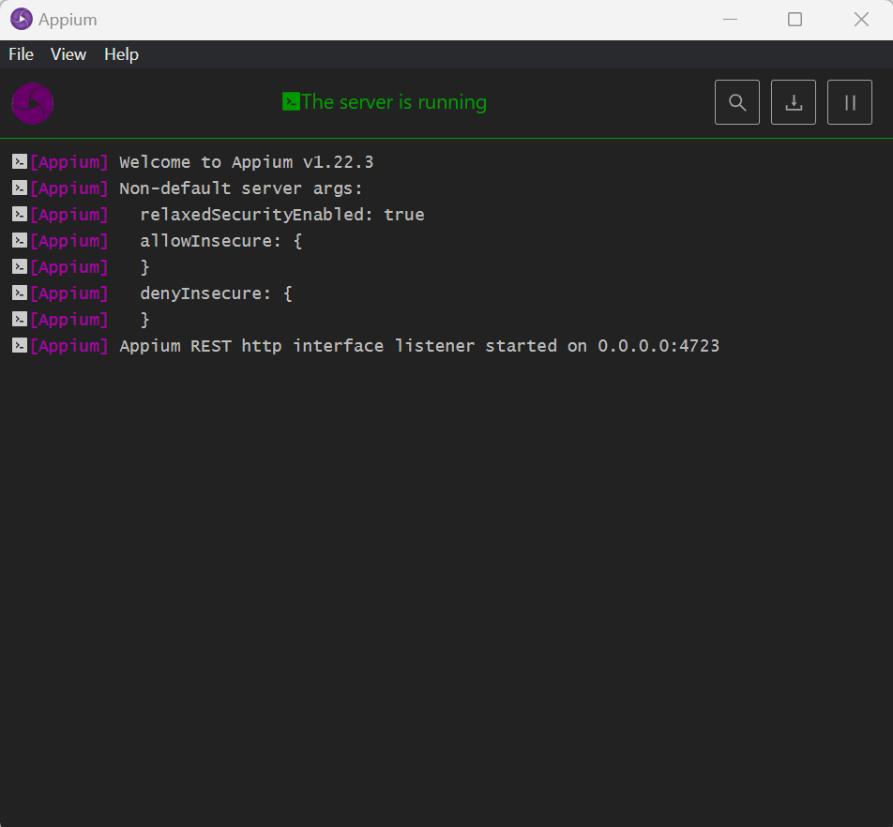
IMPLEMENTATION OF TESTING

Slide 14
CONCLUSION
A scientific calculator is a type of electronic calculator, usually but not always handheld, designed to calculate problems in science, engineering, and mathematics.
They have completely replaced slide rules in traditional applications, and are widely used in both education and professional settings

Slide 15


